Slide 1
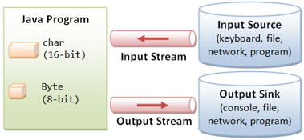
Java Programming
Files & I/O
文件及输入输出

Slide 2
Outline
Files
Streams
Byte-Based I/O*
Character-Based I/O
FileReader & FileWriter
BufferedReader & BufferedWriter

Slide 3
Files
For permanent storage, computers use files.
Files are organized into directories (sometimes called folders).
A directory can hold other directories, as well as files. Both directories and files have names that are used to identify them.
The class java.io.File can represent either a file or a directory.

Slide 4
Path string
A path string is used to locate a file or a directory. Unfortunately, path strings are system dependent, e.g.,
"c:\\myproject\\java\\Hello.java" in Windows
or "/myproject/java/Hello.java" in Unix/Mac.
Path strings | Unix/Mac | Windows
directory separator | forward-slash '/' | back-slash '\'
path separator | use colon ':' | use semi-colon ';'
line delimiter | use "\n" | uses “\r\n".
root | uses single root ("\") | uses multiple roots, each maps to a drive (e.g., "c:\", "d:\")

Slide 5
Creating a File
You can construct a File instance with a path string or URI, as follows.
Constructs a File object.
public File(String pathString)
public File(String parent, String child)
public File(File parent, String child)
Creates a new, empty file named by this abstract pathname if and only if a file with this name does not yet exist.
public boolean createNewFile() throws IOException

Slide 6
Frequently used methods
public boolean mkdir() //Creates this directory.
public boolean exists() //Tests if this file/directory exists.
public String getName() //Returns the file/directory name
public String getAbsoluteFile() // Returns the absolute file/directory name
public boolean isDirectory() //Tests if this instance is a directory.
public String getParent() //Returns the parent directory name
public boolean isFile() //Tests if this instance is a file.
public long length() //Returns the length of this file.
public long lastModified() //Returns the last modified time of this file
public boolean canRead() //Tests if this file is readable.
public boolean canWrite() //Tests if this file is writable.
public boolean delete() //Deletes this file/directory.
public boolean renameTo(File dest) //Renames this file.

Slide 7
List Directory
List Directory
public String[] list() // List the contents of this directory in a String-array
public File[] listFiles() // List the contents of this directory in a File-array
List Directory with Filter
public String[] list(FilenameFilter filter)
public File[] listFiles(FilenameFilter filter)
public File[] listFiles(FileFilter filter)
Notice:
FilenameFilter is an interface, which has a following method to test if a specified file should be included in a file list.
Boolean accept(File dir, String name)

Slide 8
Example: List all folders and files
import java.io.File;
public class ListDirectoryRecusive {
public static void main(String[] args) {
File dir = new File("d:\\myproject\\test"); // Escape sequence needed for '\'
listRecursive(dir);
}
public static void listRecursive(File dir) {
if ( dir.isDirectory() ) {
File[] items = dir.listFiles();
for (File item : items) {
System.out.println( item.getAbsoluteFile() );
if ( item.isDirectory() ) listRecursive(item); // Recursive call
}
}
}
}

Slide 9
Example: Find all java files
import java.io.File;
import java.io.FilenameFilter;
public class ListDirectoryWithFilter {
public static void main(String[] args) {
File dir = new File("."); // current working directory
if (dir.isDirectory()) {
// List only files that meet the filtering criteria.
String[] files = dir.list( new FilenameFilter() {
public boolean accept(File dir, String file) {
return file.endsWith(".java");
}
}); // an anonymous inner class as FilenameFilter
for (String file : files) {
System.out.println(file);
}
}
}
}

Slide 10
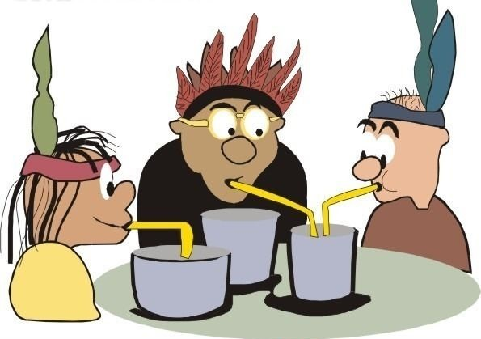
Streams(流)

Slide 11
Streams
Programs read inputs from data sources (e.g., keyboard, file, network, memory buffer, or another program) and write outputs to data sinks (e.g., display console, file, network, memory buffer, or another program).
If a programming language had to deal with each type of device as a special case, the complexity would be overwhelming.

Slide 12
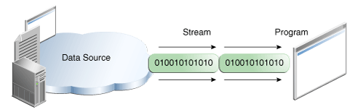
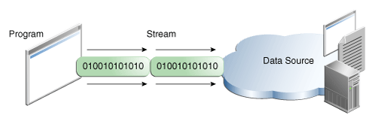
Streams
The good facilities for doing input and output is to provide universal abstractions for representing I/O devices.
In Java, In Java, the main I/O abstractions are called streams.
A stream is a sequential and contiguous one-way flow of data (just like water or oil flows through the pipe).

Slide 13
Streams
The beauty of the stream abstraction is that it is as easy to write data to a file or to send data over a network as it is to print information on the screen.
The standard stream classes discussed are defined in the package java.io, along with several supporting classes.

Slide 14
Streams
Java supports several types of streams, but no matter what type you are going to use, the following three steps should be done in your program:
Open a stream that points at some data store e.g. a file.
Read or write data from/to this stream.
Close the stream (Java can do it automatically).

Slide 15
Streams
There are two broad categories of data: machine-formatted data and human-readable text.
As a consequence, Java needs to differentiate between byte-based I/O for processing raw bytes or binary data, and character-based I/O for processing texts made up of characters.

Slide 16
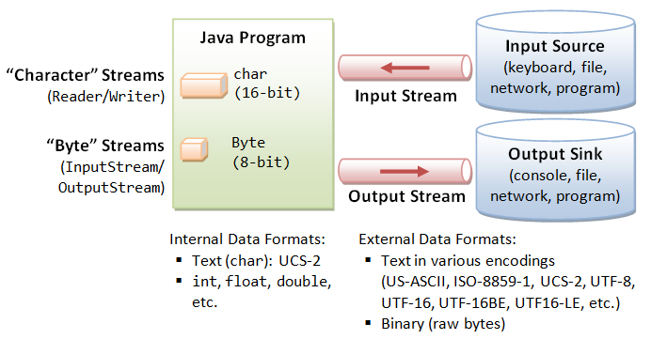
Streams
Notes:
http://www3.ntu.edu.sg/home/ehchua/programming/java/J5b_IO.html

Slide 17
Byte-based I/O*
Byte streams can be useful for direct machine-to-machine communication, and they can sometimes be useful for storing data in files, especially when large amounts of data need to be stored efficiently.
However, binary data is fragile in the sense that its meaning is not self-evident.
For files that store data in machine format, the appropriate I/O classes are FileInputStream and FileOutputStream.
Notice:
We will not talk about byte-based I/O in this course.

Slide 18
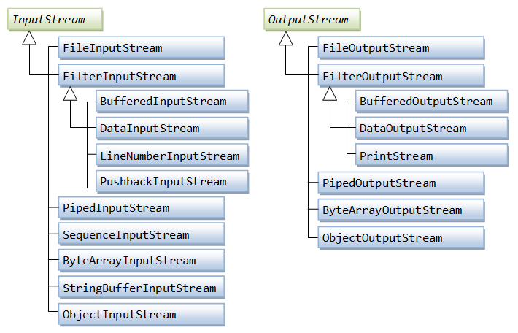
Byte-based I/O*

Slide 19
Example: Java Standard I/O
System.in
System.in is an InputStream which is typically connected to keyboard input of console programs.
System.out
System.out is a PrintStream. System.out normally outputs the data you write to it to the console.
System.err
System.err is a PrintStream. System.err works like System.out except it is normally only used to output error texts.
Some programs (like Eclipse) will show the output to System.err in red text, to make it more obvious that it is error text.

Slide 20
Character-Based I/O
The character data are also coded as binary numbers.
But the character data has been standardized and is well understood, and data expressed in character form can be made meaningful to human readers.
The current trend seems to be towards increased use of character data, represented in a way that will make its meaning as self-evident as possible.

Slide 21
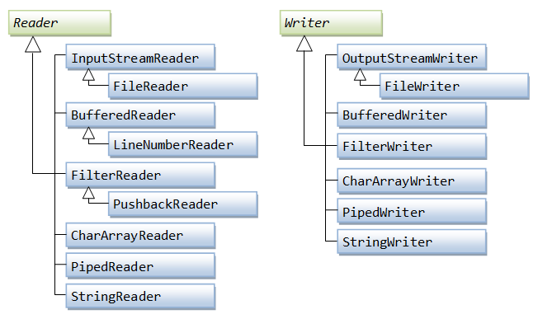
Character-Based I/O

Slide 22
FileReader & FileWriter
Human-readable character data can be read from a file using an object belonging to the class FileReader.
Similarly, data can be written to a file in human-readable format through an object of type FileWriter.

Slide 23
FileReader
public FileReader(String fileName)
throws FileNotFoundException
Creates a new FileReader, given the name of the file to read from.
Parameters:
fileName - the name of the file to read from
Throws:
FileNotFoundException - if the named file does not exist, is a directory rather than a regular file, or for some other reason cannot be opened for reading.

Slide 24
FileReader
Constructor using File object
public FileReader(File file) throws FileNotFoundException
Read data from file
public int read() throws IOException //read a single character.
return -1 if the end of the stream has been reached
public String readLine() throws IOException //Reads a line of text.
return null if the end of the stream has been reached

Slide 25
FileWriter
public FileWriter(String fileName, boolean append)
throws IOException
Function
Constructs a FileWriter object given a file name with a boolean indicating whether or not to append the data written.
If the file does not exist, it creates the file.
Parameters:
fileName - String The system-dependent filename.
append - boolean if true, then data will be written to the end of the file rather than the beginning.
Throws:
IOException - if the named file exists but is a directory rather than a regular file, does not exist but cannot be created, or cannot be opened for any other reason

Slide 26
FileWriter
Other constructrs
FileWriter(String fileName) throws IOException
FileWriter(File file) throws IOException
FileWriter(File file, boolean append) throws IOException
Write data to file
void write(int c) //Writes a single character.
void write(String str) //Writes a string.

Slide 27
Code structure using FileReader
FileReader reader;
try {
reader = new FileReader("data.txt");
… //read data and process them
}
catch (FileNotFoundException e) {
... // do something to handle the error
}

Slide 28
Code structure using FileWriter
FileWriter writer;
try {
writer = new FileWriter(fileName, false);
… // write data
} catch (IOException e) {
… // do something to handle the error
}

Slide 29
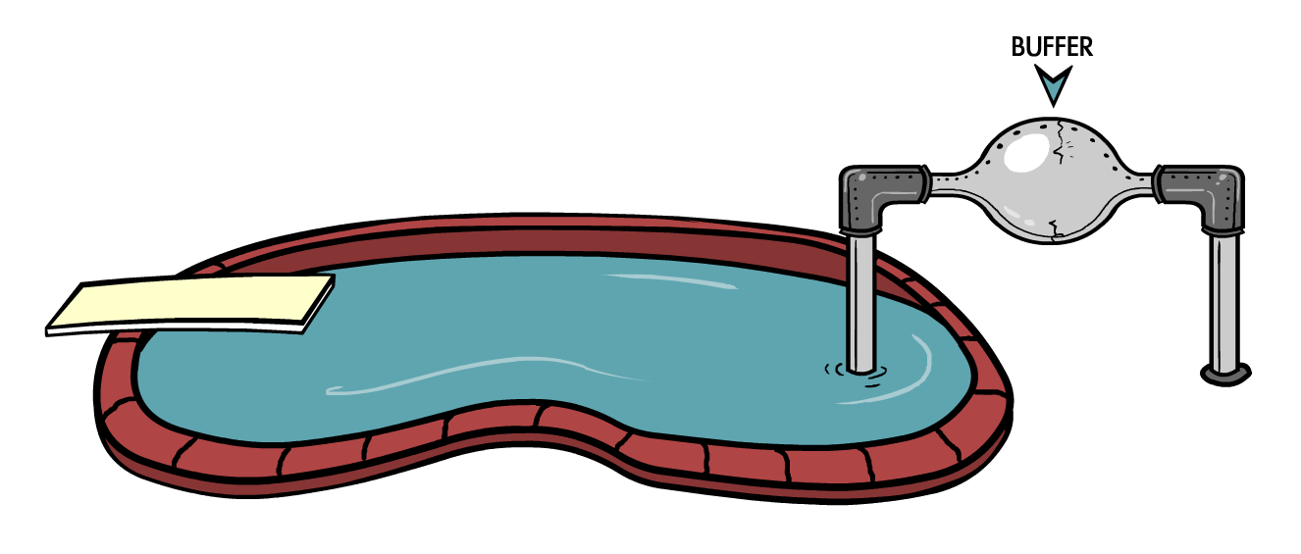
BufferedReader/BufferedWriter
Reads/writes text from/into a character stream, buffering characters so as to provide for the efficient reading/writing of characters, arrays, and lines.
Notes:
In general, disk access is much slower than the processing performed in memory; that’s why it’s not a good idea to access the disk a thousand times to read a file of 1,000 bytes. To minimize the number of times the disk is accessed, Java provides buffers, which serve as reservoirs of data.
The main idea here is to minimize disk access. Buffered streams are not changing the type of the original streams — they just make reading more efficient. A program performs stream chaining (or stream piping) to connect streams, just as pipes are connected in plumbing.

Slide 30
BufferedReader
Constructors
Public BufferedReader(Reader in)
Creates a buffering character-input stream that uses a default-sized input buffer with specified Reader object.
BufferedReader(Reader in, int sz)
Creates a buffering character-input stream that uses an input buffer of the specified size with specified Reader object.
default size is 8K bytes
Read data from file
public int read() throws IOException //read a single character.
return -1 if the end of the stream has been reached
public String readLine() throws IOException //Reads a line of text.
return null if the end of the stream has been reached

Slide 31
BufferedWriter
Constructors
BufferedWriter(Writer out)
Creates a buffered character-output stream that uses a default-sized output buffer.
BufferedWriter(Writer out, int sz)
Creates a new buffered character-output stream that uses an output buffer of the given size.
Write data to file
void write(int c) //Writes a single character.
void write(String str) //Writes a string.

Slide 32
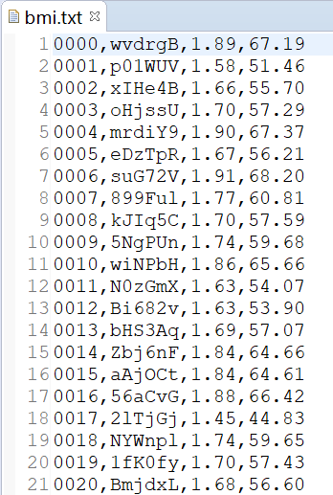
Example: save BMI data
public void saveFile(ArrayList<Student> students,String fileName) {
try {
BufferedWriter writer =
new BufferedWriter(new FileWriter(fileName, false));
for(Student st: students){
writer.write(String.format("%s,%s,%.2f,%.2f\r\n",
st.id,st.name,st.height,st.weight));
}
writer.close();
} catch (IOException e) {
e.printStackTrace();
}
}

Slide 33
Example: Read BMI data
public ArrayList<Student> readFile(String fileName) {
File file = new File(fileName);
BufferedReader reader = null;
ArrayList<Student> v= new ArrayList<Student>();
try {
reader = new BufferedReader(new FileReader(file));
String tempString = null;
while ((tempString = reader.readLine()) != null) {
String[] a= tempString.split(",");
Student st= new Student(a[0],a[1],Double.parseDouble(a[2]),Double.parseDouble(a[3]));
v.add(st);
}
reader.close();
} catch (IOException e) {
e.printStackTrace();
}
return v;
}

Slide 34
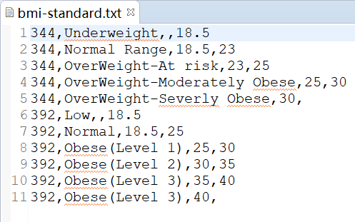
The showXXXXCategory problem
The users may be from all over the world, and there are different standards for the BMI ranges.
Should we define a new showXXXXCategory method if our program was sold in a new country?
Can we extend the BMI program without modifying the code?

Slide 35
Example: Read bmi-standard.txt
public Vector<String[]> readFileByLines(String fileName) {
File file = new File(fileName);
BufferedReader reader = null;
Vector<String[]> v= new Vector<String[]>();
try {
reader = new BufferedReader(new FileReader(file));
String tempString = null;
while ((tempString = reader.readLine()) != null) {
String[] a= tempString.split(",");
v.add(a);
}
reader.close();
} catch (IOException e) {
e.printStackTrace();
}
return v;
}

Slide 36
Example: Get the BMI standard
public Vector<String[]> getCategory(String country) {
Vector<String[]> category = readFileByLines("bmi-standard.txt");
Vector<String[]> v = new Vector<String[]>();
for(String[] s:category){
if(s[0].equals(country));
v.add(s);
}
return v;
}

Slide 37
Example: show the BMI Category
public String showCategory(double bmi, Vector<String[]> category) {
String type="Not Defined";
double start,end;
for(String[] s:category){
start=Double.parseDouble(s[2].equals("")?"0":s[2]);
end=Double.parseDouble(s[3].equals("")?"999":s[3]);
if(bmi>start && bmi<=end) {
type=s[1];
return type;
}
}
return type;
}

Slide 38
Example: Counting lines of code
Lines of code (LOC), is a software metric used to measure the size of a computer program by counting the number of lines in the text of the program's source code.
LOC is typically used to predict the amount of effort to develop a program, or to estimate the maintainability of a program.

Slide 39
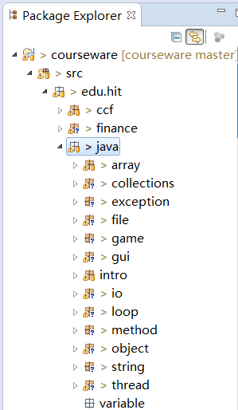
Counting lines of code
We classify lines of code into three types:
White lines
Comment lines
Normal lines
We are going to count the three types of the LOCs respectively for all the java source files in the workspace of Eclipse.

Slide 40
public class LineCounter {
private int whiteLines=0;
private int commentLines=0;
private int normalLines=0;
private int totalLines=0;
private int totalFiles=0;
public void treeFiles(File path) {…}
private void countFile(File file) {…}
private void countLines(BufferedReader br) {…}
public static void main(String args[]) {…}
}

Slide 41
public void treeFiles(File path) {
File[] childs = path.listFiles();
for (int i = 0; i < childs.length; i++) {
if (!childs[i].isDirectory()) {
if (childs[i].getName().endsWith(".java")) {
System.out.println("counting..." + childs[i].getName() );
countFile(childs[i]);
totalFiles++;
}
} else {
treeFile(childs[i]);
}
}
}

Slide 42
private void countFile(File file) {
BufferedReader br = null;
try {
br = new BufferedReader(new FileReader(file));
countLines(br);
} catch (FileNotFoundException e) {
e.printStackTrace();
} finally {
if (br != null) {
try {
br.close();
br = null;
} catch (IOException e) {
e.printStackTrace();
}
}
}

Slide 43
private void countLines(BufferedReader br) {
String line = "";
boolean comment = false;
try {
while ((line = br.readLine()) != null) {
line = line.trim(); totalLines++;
if (line.length()==0) {
whiteLines++;
} else if (line.startsWith("/*") && line.endsWith("*/")) {
commentLines++;
} else if (line.startsWith("/*") && !line.endsWith("*/")) {
commentLines++;
comment = true;
} else if (true == comment) {
commentLines++;
if (line.endsWith("*/")) comment = false;
} else if (line.startsWith("//")) {
commentLines++;
} else {
normalLines++;
}
}
} catch (IOException e) {
e.printStackTrace();
}
}

Slide 44
public static void main(String args[]) {
File path = new File(args[0]);
long start=System.currentTimeMillis();
System.out.println("counting dictionary:"+args[0]);
LineCounter lc= new LineCounter();
lc.treeFiles(path);
System.out.println("counting is finishing!");
System.out.println("commentLines:"+lc.commentLines);
System.out.println("normalLines:"+lc.normalLines);
System.out.println("whiteLines:"+lc.whiteLines);
System.out.println("totalLines:"+lc.totalLines);
long end=System.currentTimeMillis();
System.out.println("your program spent "+(end-start)+"ms");
}

